Slide 1
Title
Sub Head Title

Slide 2
Data-driven Visualizations

Slide 3
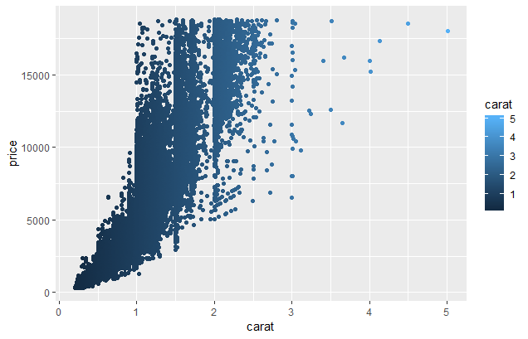
What is effective about this? What is not?

Slide 4
What is effective about this? What is not?
Effective
No optical illusions
Not effective
Extraneous grid lines
Unnecessary color
Low contrast between shades of blue
Font sizes (presentations vs manuscripts)

Slide 5
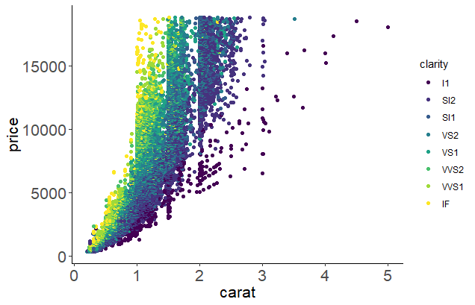
What improvements can we make?
Increased data density with colors
No optical illusions
Color contrasts
Removed grid lines
Increased font size for readability

Slide 6
What else could we improve?
Test or change color to grayscale
Increase legend size
What is clarity? Is it ordered?
For a presentation, rotate y-axis label to horizontal
Add commas (or periods in Europe) to large numbers if domain- or journal-specific allows

Slide 7
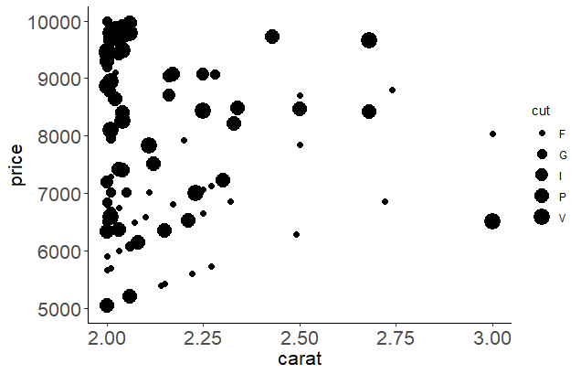
What is clear or misleading about this?

Slide 8
What is clear or misleading about this?
Clear
Chart design consistent throughout
Units appropriate
Potentially misleading
Symbols and axes proportional to numbers represented (problem with pie charts, area in general)
Lack of context: did not show all relevant data
Clear labels (minimize abbreviations)

Slide 9
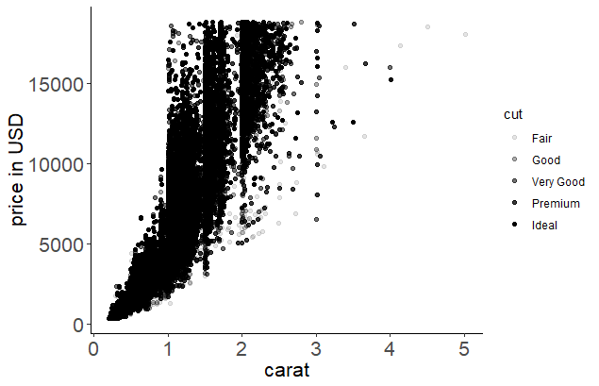
What improvements can we make?
Removed area-cut relationship
Show full range of data
Units for y-axis
Labels not abbreviated

Slide 10
What else could we improve?
Decide if data density in interior is acceptable
Make “fair” easier to see from a distance (darker color)
Make all points easier to see from a distance (larger size)
Consider goal – do we need all cut categories?

Slide 11
Please take 3 min to help us improve
Survey link: http://bit.ly/oulib_davis_workshop
Today’s topic: Data-driven visualizations
Notes:
For those who didn’t bring a device, offer to email them via EventBrite

Slide 12
Find more resources and upcoming events!
Impact Challenge https://libraries.ou.edu/ impactchallenge
Feb 4-8: Make your data discoverable
Feb. 11-15: Share software with Github
Feb. 18-22: Understand DOIs
Carpentries two-day workshops https://libraries.ou.edu/ carpentries
Digital Skills Hub Calendar https://digitalskills.oucreate.com
Information Specialists @ DAVIS https://libraries.ou.edu/davis
Digital Scholarship Lab https://libraries.ou.edu/dsl

Slide 13
Agenda
Introduction
Content Point #1
Content Point #2
Content Point #3
Conclusion

Slide 14
Slide Title
Bullet point list
Text placeholder
Talking point
Concept reinforcement

Slide 15
Slide Title

Slide 16
Slide Title
White background, crimson font for titles; black, bold, or semi-bold for subheaders, black medium for primary text.

Slide 17
Slide Title
Approved font is Arial (sans-serif), for universal use on Mac and Windows

Slide 18
Slide Title
All text should be a minimum of 32 pt font (36 pt font for headers)
UL logo will be located toward the bottom right-aligned (not the far right corner) on all slides.

Slide 19
Slide Title
No more than 4 bullet points per slide
No more than 2 sentences per slide

Slide 20
Slide Title
Charts should incorporate these colors:
#8D1732 (Official OU red)
#000000 (Supporting color)
#298ac4 (Supporting color)
#cccccc (Supporting color)
#94c893 (OU web footer color)

Slide 21
Slide Title
Speaker Name
Title
Contact Information

